Slide 1
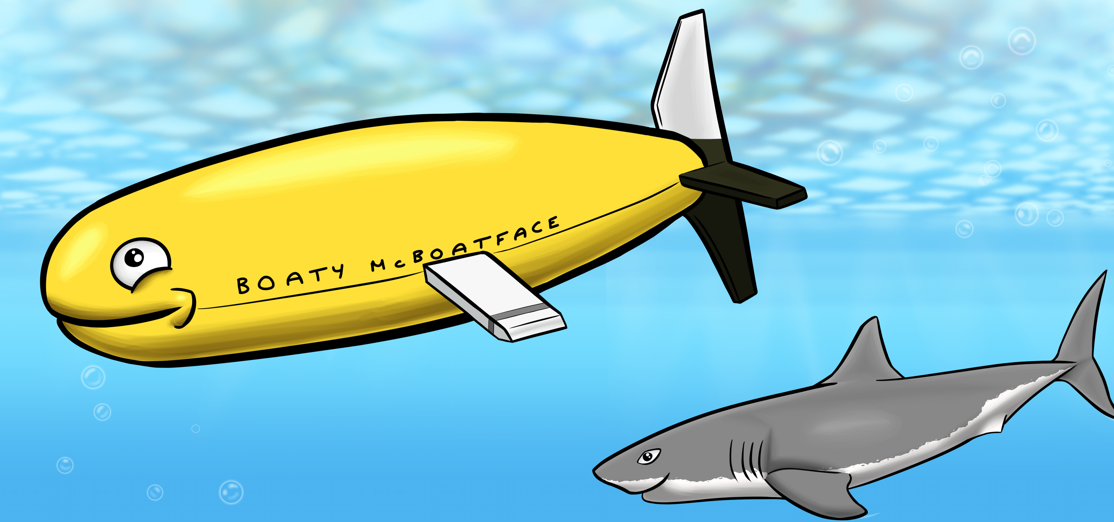
Terrain-Aided Navigation for Long-Range AUVs Operating in Uncertain Environments
Ph.D. Thesis
Georgios Salavasidis
27.06.2019
Supervisors:
Prof. Eric Rogers (UoS)
Dr Alexander Phillips (NOC)

Slide 2
Presentation Outline
Motivation & Aim
Existing Navigation Techniques & Limitations
Long-Range Navigation (Terrain-Aided Navigation)
Results (….briefly)
Discussion & Future Directions
Optional: real-time TAN (video)

Slide 3
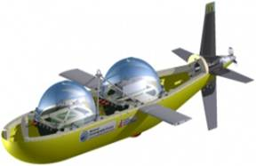
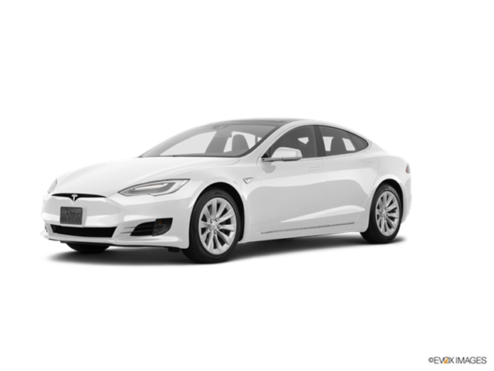
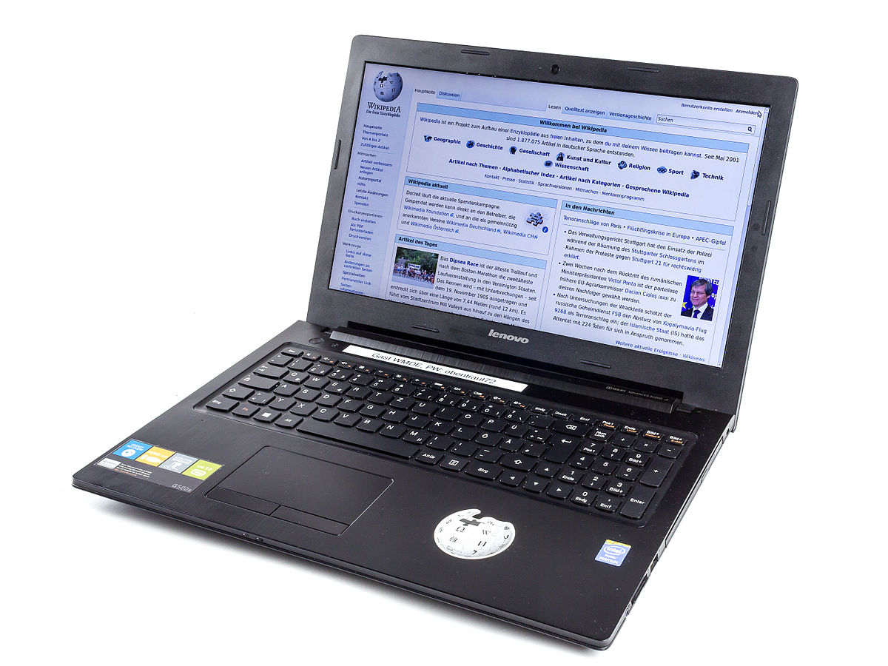
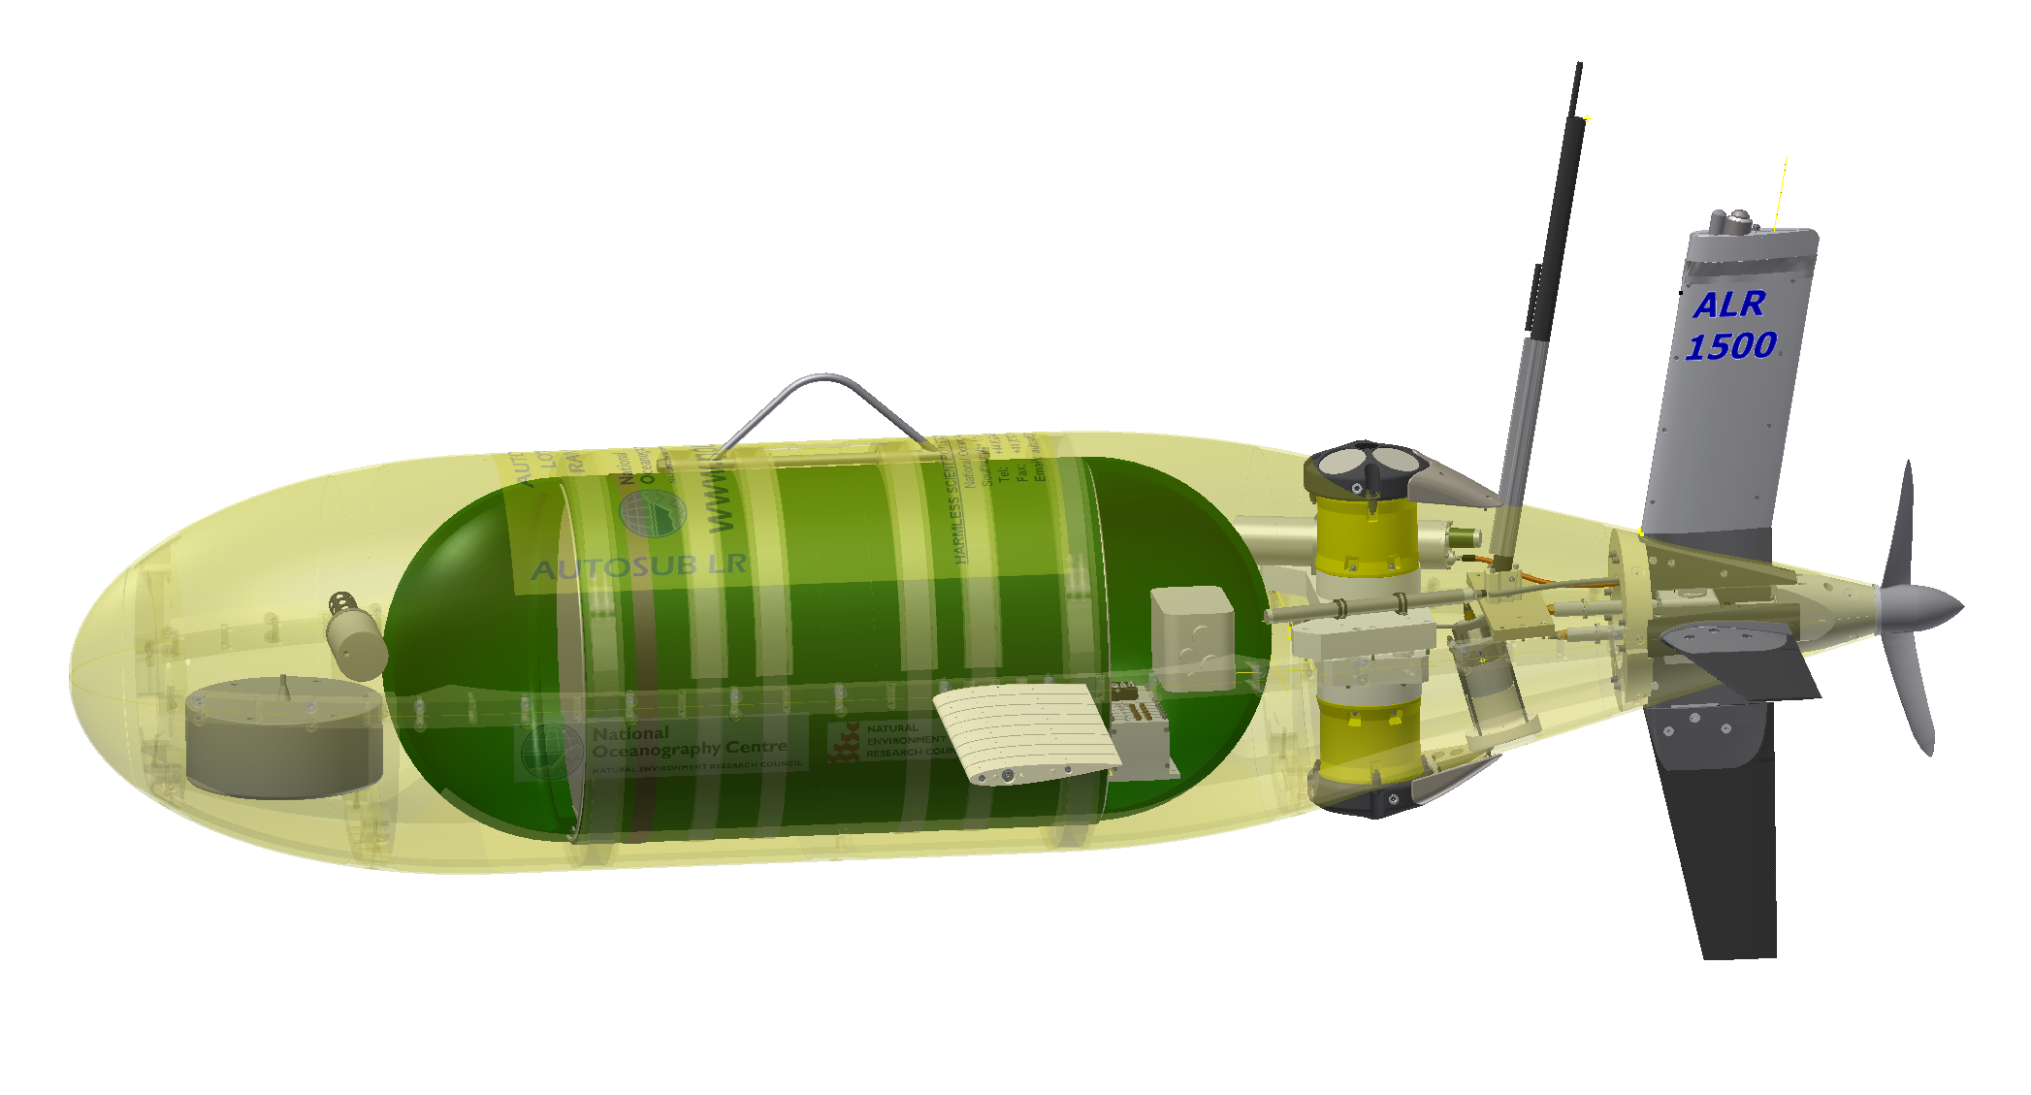
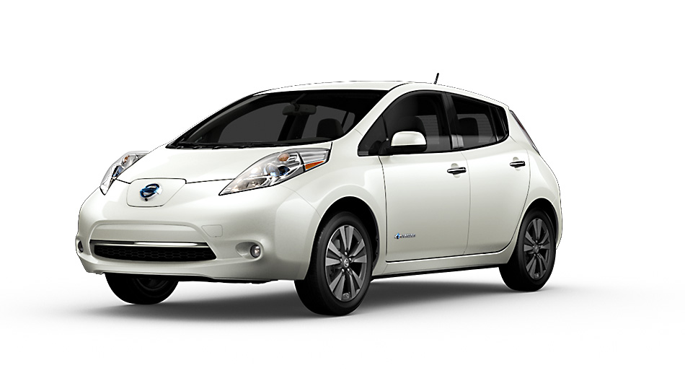
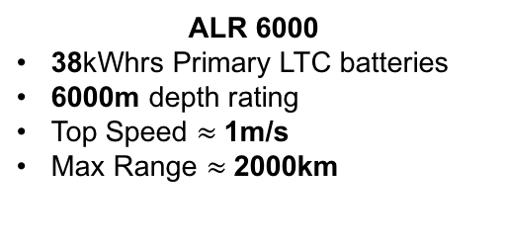
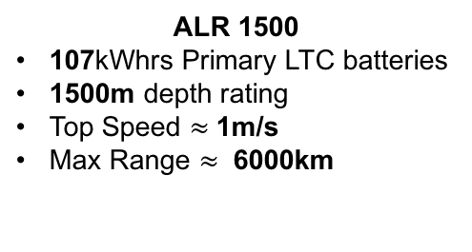
Long-Range AUVs & Navigation Research Motivation & Aim
A key outstanding challenge is…..
navigation (no GPS)!
ALR 6000
38kWhrs Primary LTC batteries
6000m depth rating
Top Speed $≈$1m/s
Max Range $≈$2000km
<0.1kWhrs
(Laptops)
38kWhrs
(ALR 6000)
100kWhrs
(Tesla S)
kWhrs
Typical dead-reckoning error is ≈ 1-2% of distance travelled in a straight line using speed over the ground
otherwise, error = f(current speed)
107kWh
(ALR 1500)
30kWhrs
(Nissan Leaf)
ALR 1500
107kWhrs Primary LTC batteries
1500m depth rating
Top Speed $≈$1m/s
Max Range $≈$ 6000km
Operations of the order of months, rather than hours or days!

Slide 4
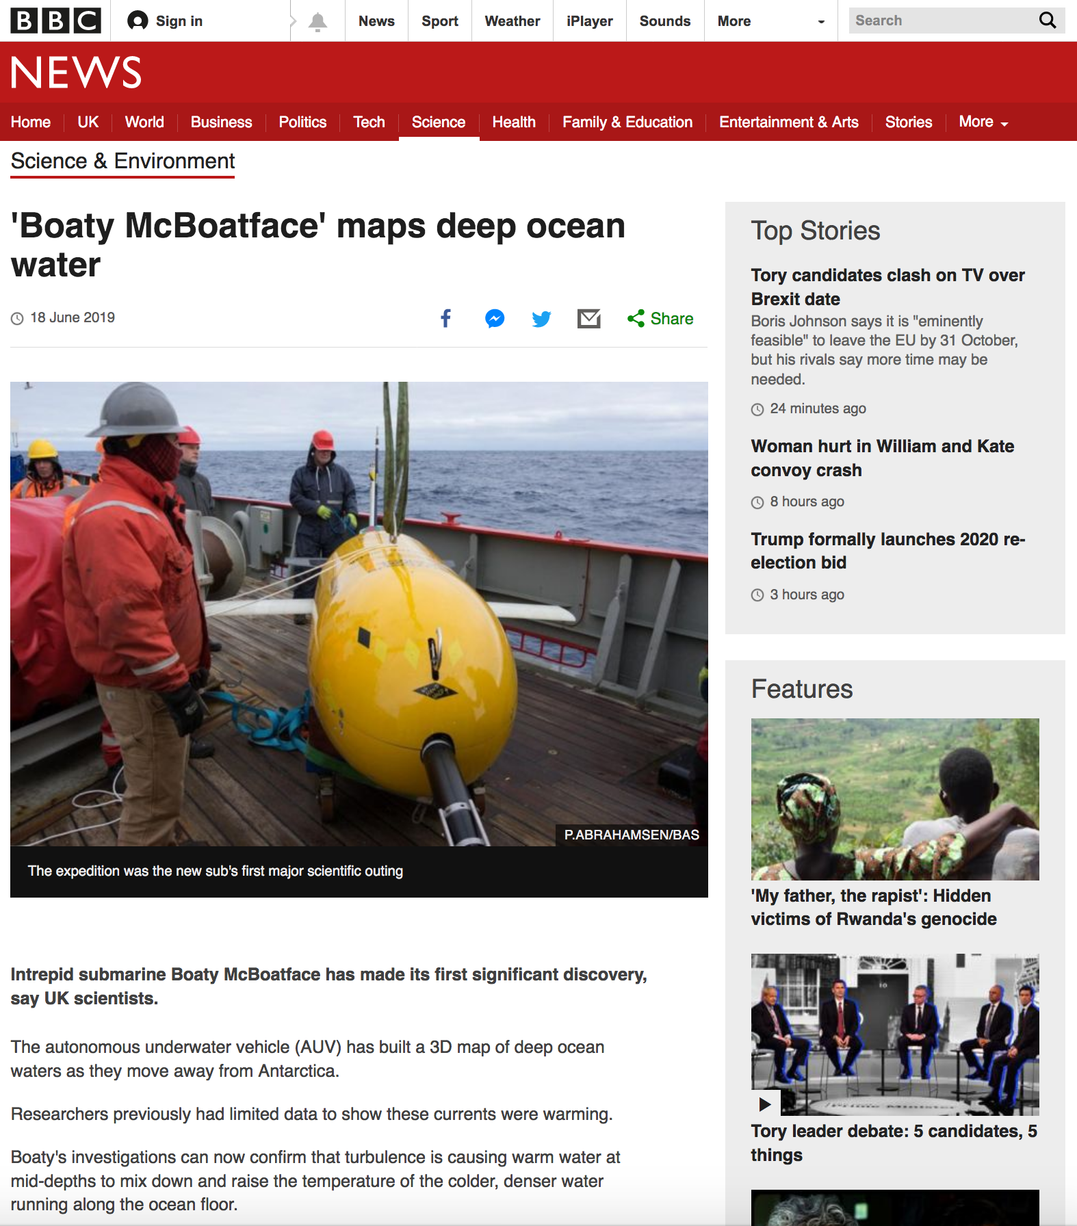
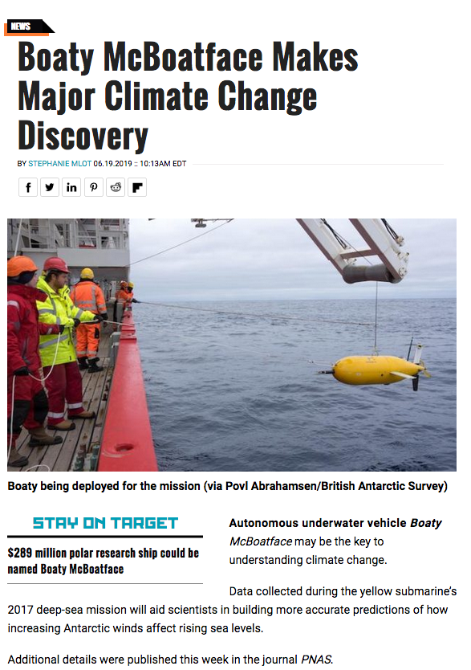
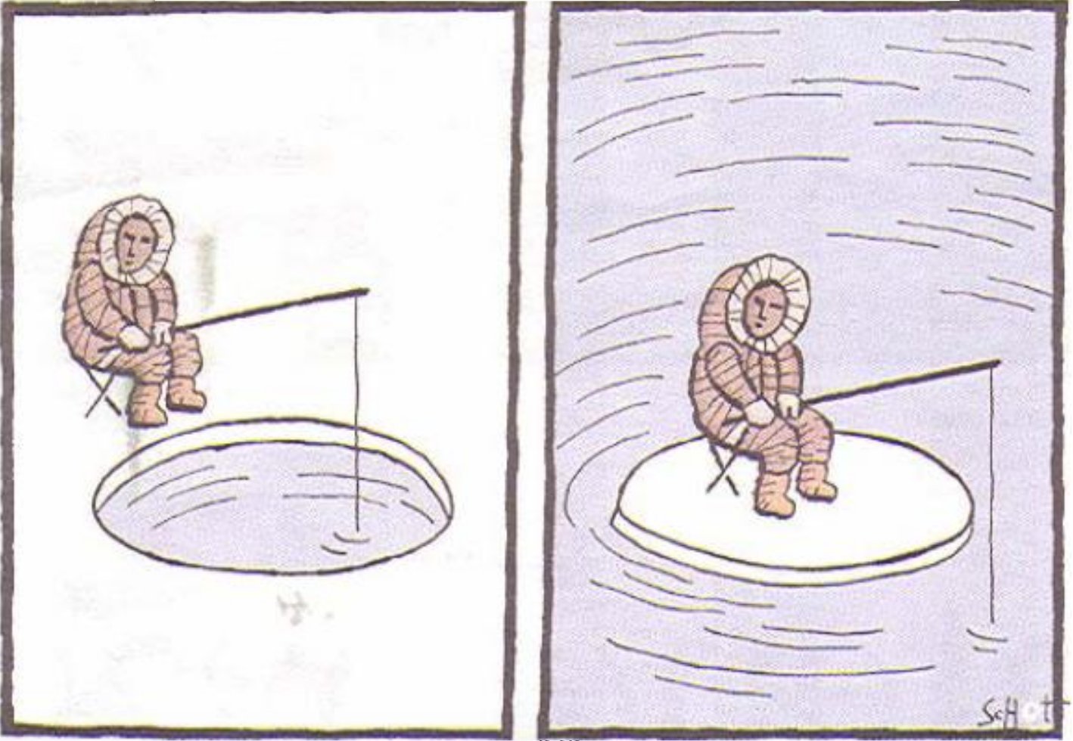
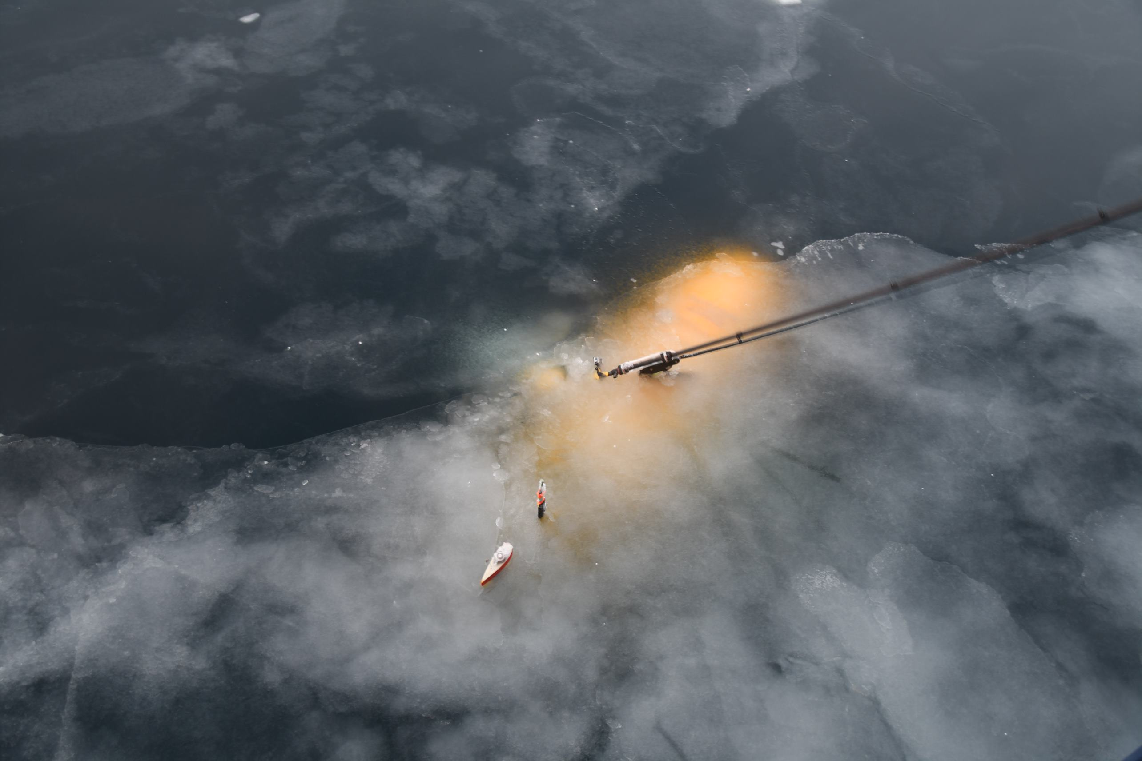
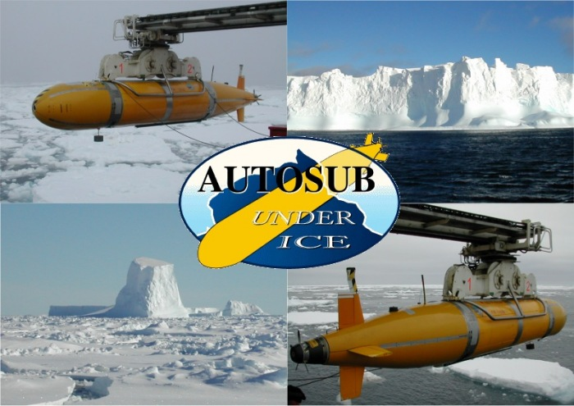
Motivating Long-Term Goal Research Motivation & Aim
Requirement: maintaining localisation error < 100 km
A need for better understanding the Arctic Ocean and the underlying processes
Crossing the Arctic Ocean
Range over 3000 km (over 2 months)
90% ice covered (no surfacing → no GPS)
No-go zones (unreliable heading)
10 – 1000 m depth (no or little bottom-track)

Slide 5
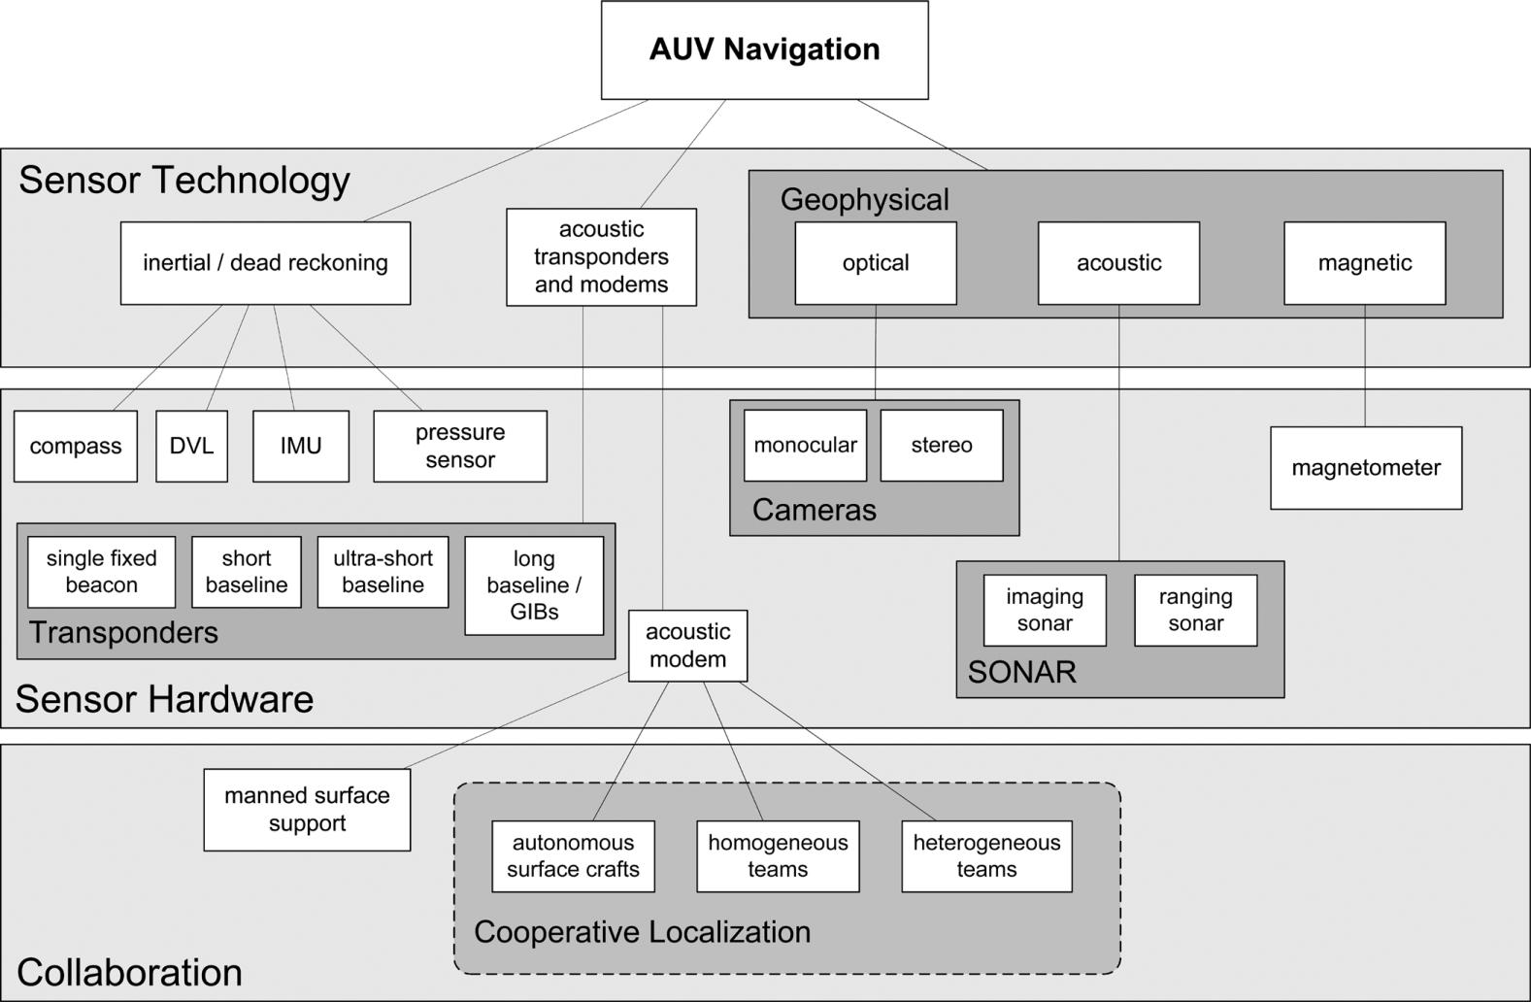
Existing Navigation Techniques & Limitations
Methodologies/Limitations
Inertial Navigation
unbounded error growth
Acoustic-Aided Navigation
need external assistance
Geophysical Navigation
need good quality maps
information-rich & power-hungry sensors
Liam Paull, Saeed Saeedi, Mae Seto, and Huaqing Li. “AUV navigation and localization: A review.” Oceanic Engineering, IEEE Journal of, 39(1):131–149, 2014.

Slide 6
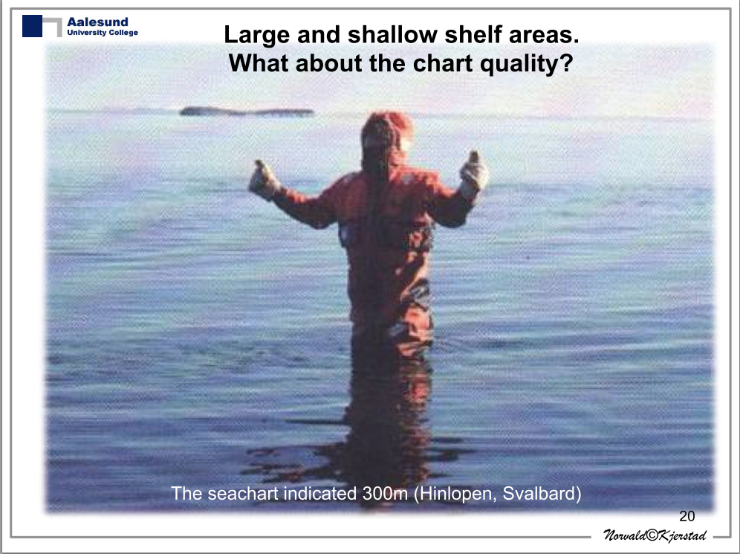
Long-Range Navigation
Terrain-Aided Navigation
exploiting physical terrain features for enabling localisation
Requirements
Unaided navigation
Low-power navigation
Computationally feasible navigation
Kjerstad, N. (2011). Ice navigation. Tapir.
a need for good maps!

Slide 7

Long-Range Terrain-Aided Navigation
Unaided navigation
no need external support
Low-power navigation
relying on small number of low-power sensors
Computationally feasible navigation
low dimension RBPF able to run on limited power processing boards
Navigation robustness
dealing with coarse maps (uncertainty quantification)
enabling re-convergence capability
filtering-out range outliers
path-planning for enhancing navigation accuracy
Evaluation using unique field data and challenging conditions
multi-day deep-water missions using BT velocity
multi-day missions using coarse maps and only WT velocity
multi-month simulated crossing of the Arctic Ocean
Realizing Bayesian Estimation via Rao-Blackwellised Particle Filter
2-D Particle Filter
$${\text{𝔁}}_{k}\text{=}\left[{x_{k} \atop c_{k}}\right]$$
2-D Kalman Filter
Low number of particles
Optimal velocity bias estimation
non-linear estimation problem

Slide 8
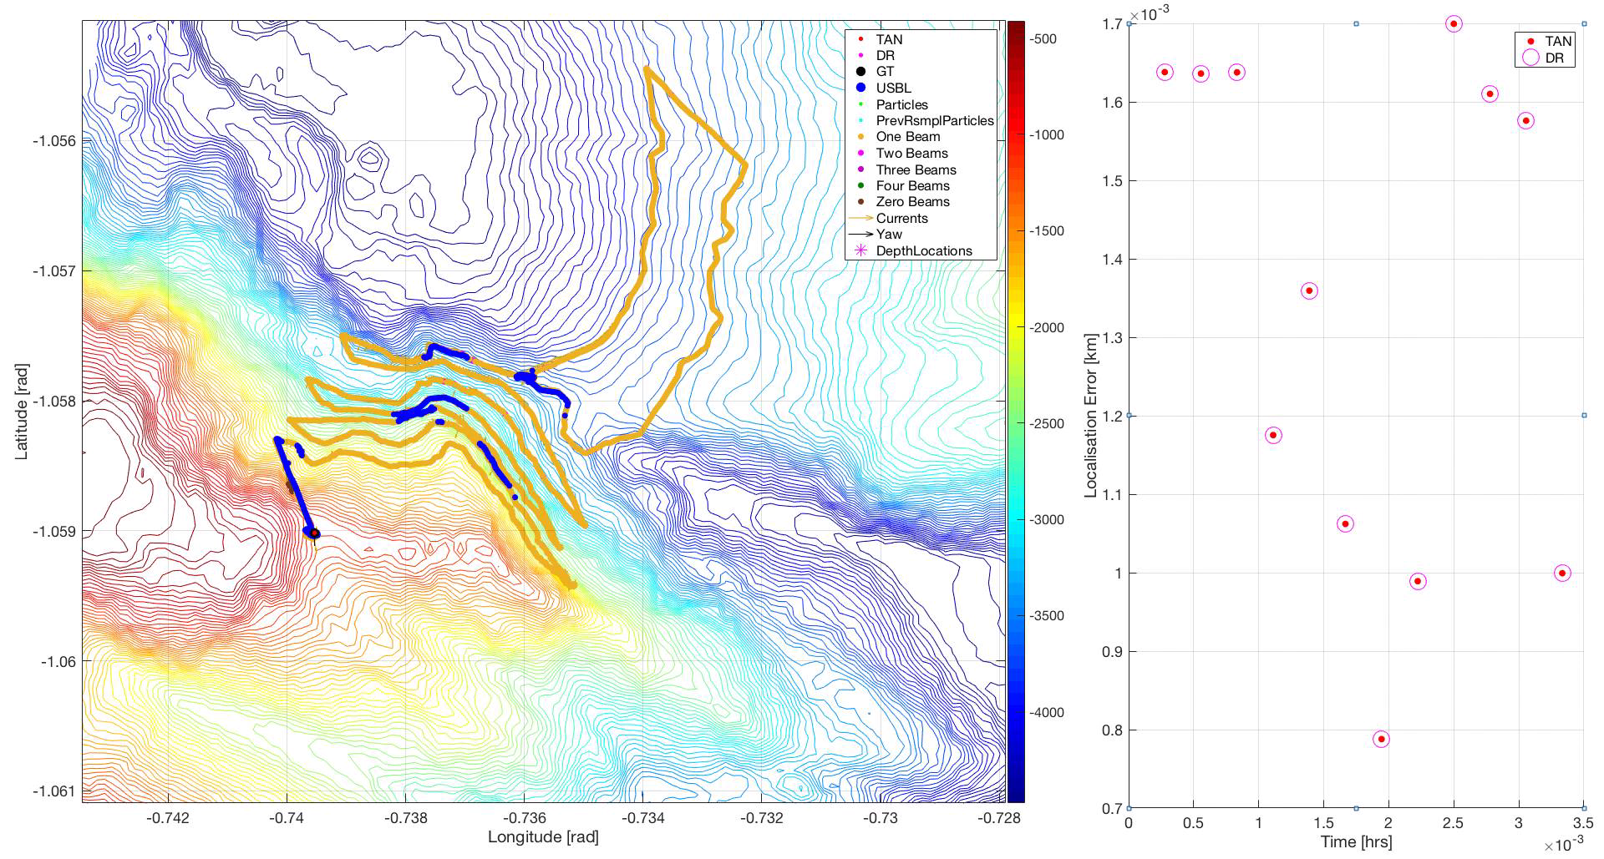
Results DynOPO M44
AUV depth 3000-4000 m
Range ≈ 200 km (over 3 days)
Speed ≈ 0.7 m/s
Strong currents (sometimes over 0.5 m/s)
400 m sub-sampled bathymetric map
Propeller RPM-based speed

Slide 9
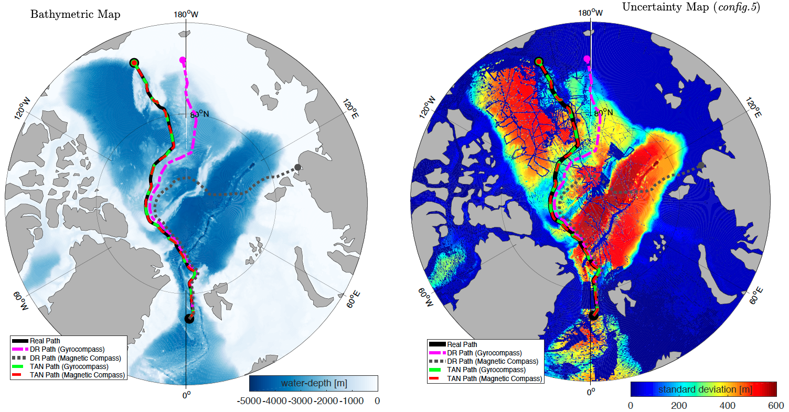
Results Simulated Crossing of the Arctic Ocean
Constant level flight at 1000 m (ALR1500)

Slide 10
Discussion & Future Directions
TAN has the potential to prolong underwater missions
It is possible to navigate using low resolution maps and basic low-power sensors
RBPF offers a feasible filtering solution on limited power processing boards
Fault detection and recovery techniques are important
Path-planning can improve the TAN performance
Improving navigation robustness:
More advanced fault detection and recovery (robustness-accuracy trade-off)
fusing additional information (magnetic, gravity, ocean fields variability*, etc.)
moving towards global bathymetric maps (better uncertainty models)
alternative estimation techniques (e.g. batch/correlation methods)
Closing the control-navigation loop
Challenges in high latitudes (e.g. emergency behaviors, minimising the gyrocompass use)
* Munafo A., Fanelli F., Salavasidis G., Storto A., Oddo P., (2019) Navigation of AUVs based on Ocean Fields Variability

Slide 11
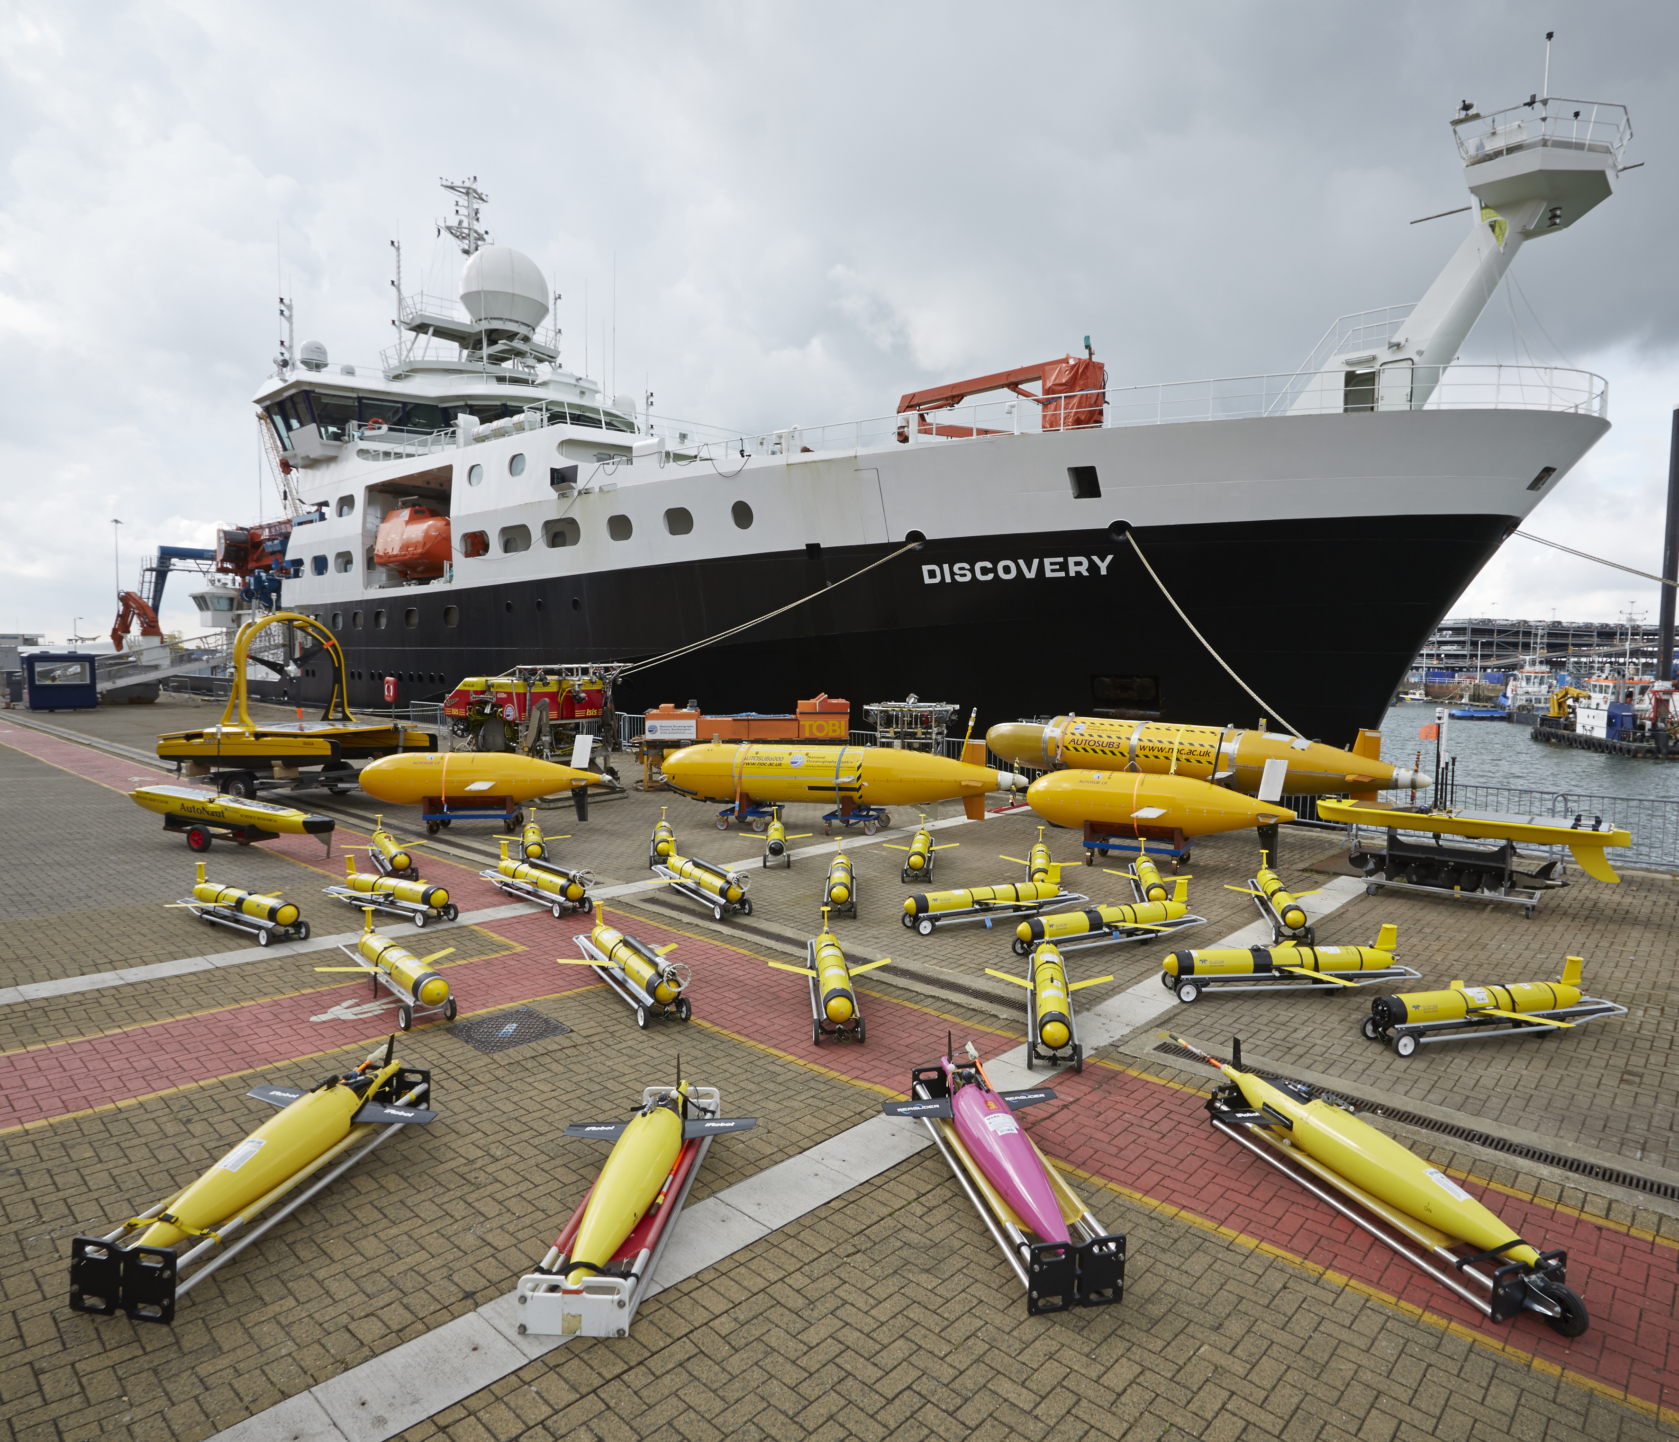
Thank you for your attention!
optional videos…next!

Slide 12
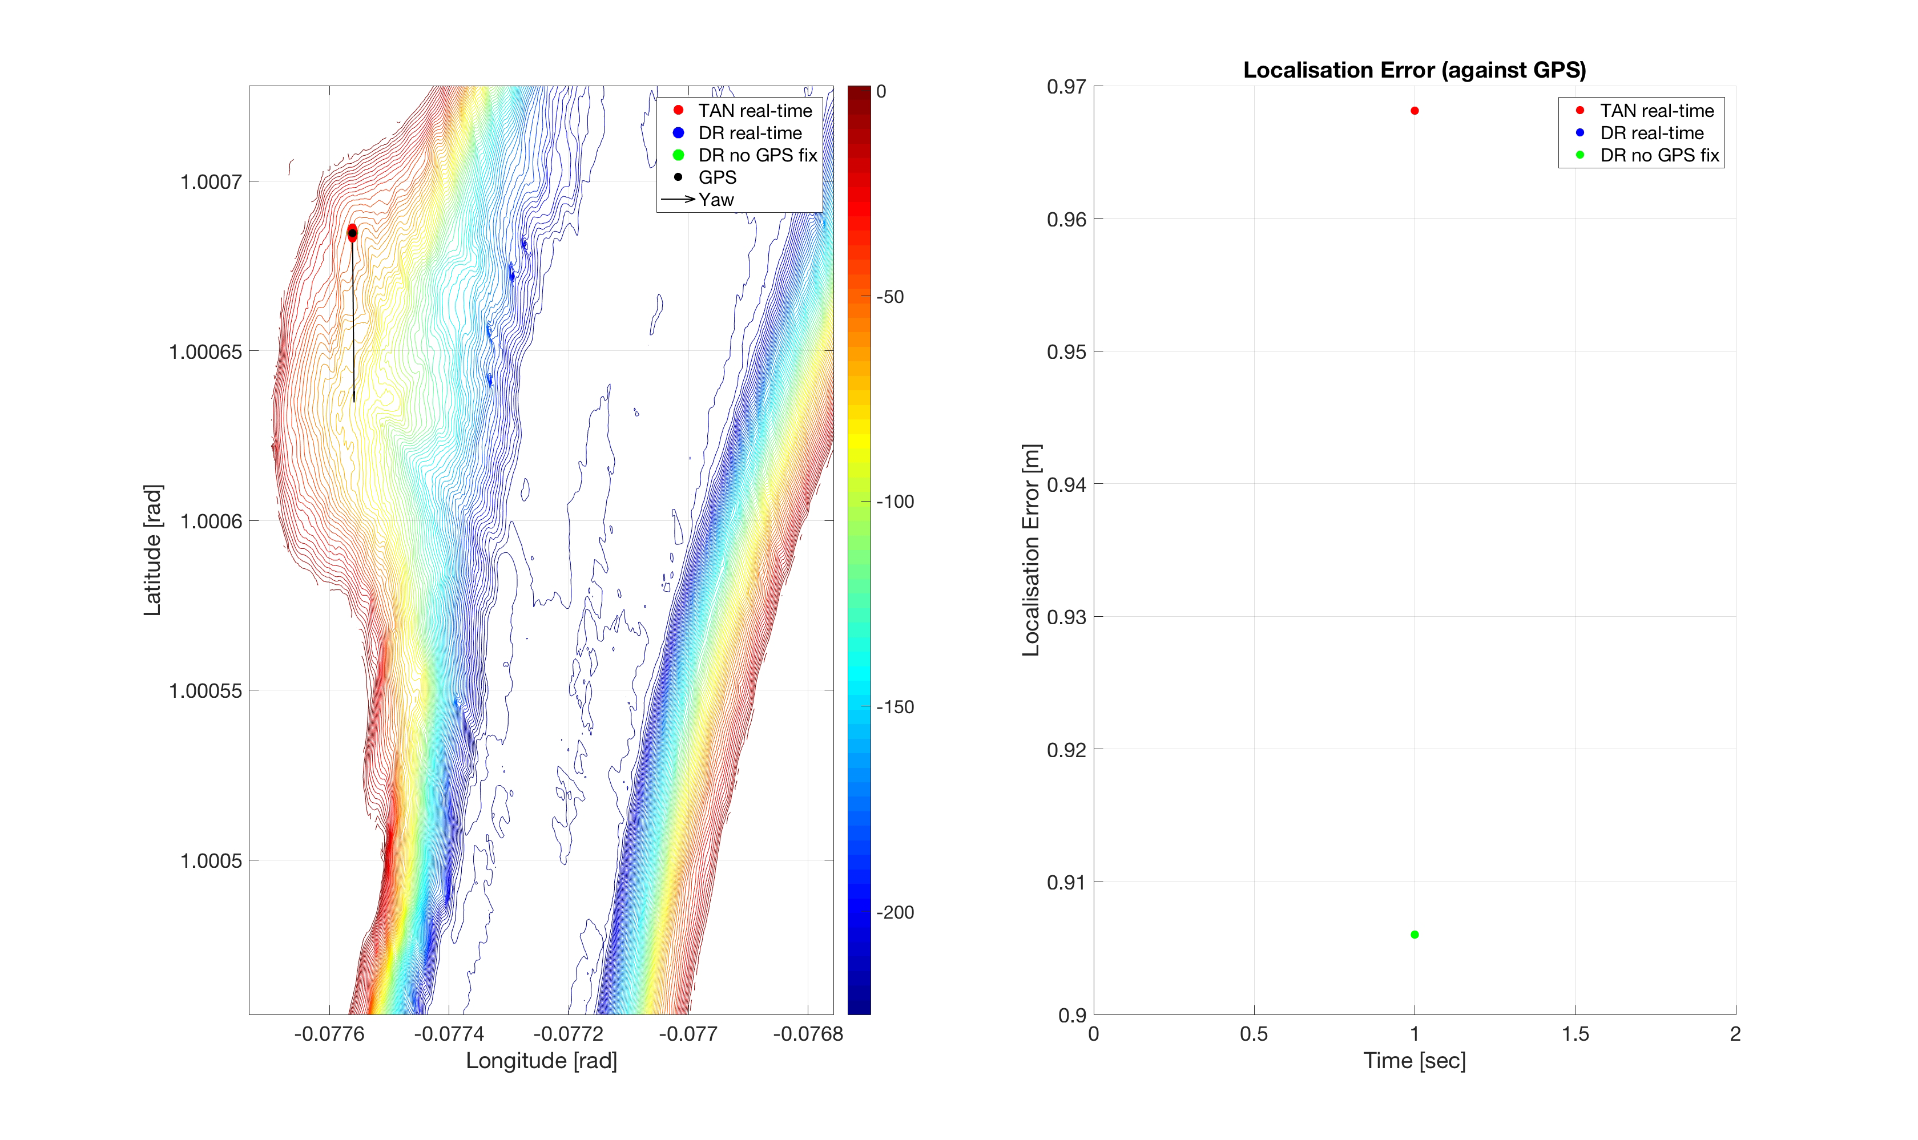
Real-Time TAN (using available BT velocity)

Slide 13
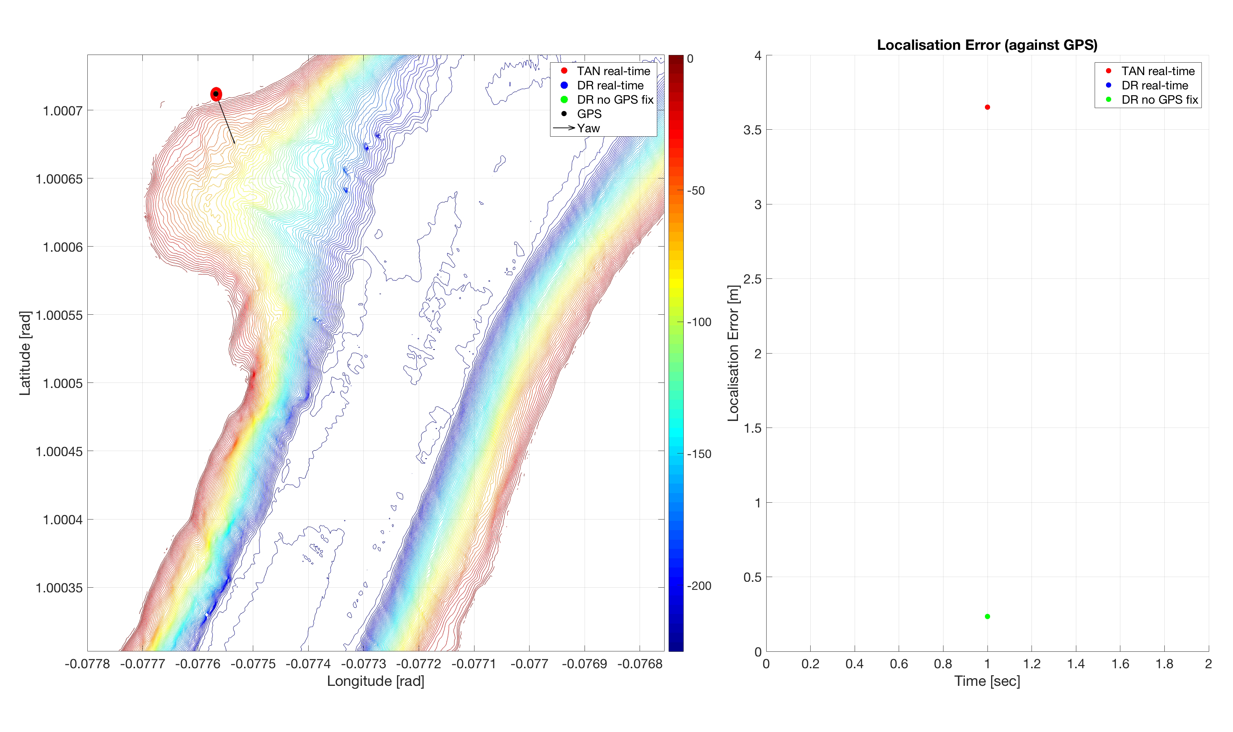
Real-Time TAN (using only WT velocity)

Slide 14
Arctic Magnetic Field

